Slide 1
Lab 5 Ray Tracing

Slide 2
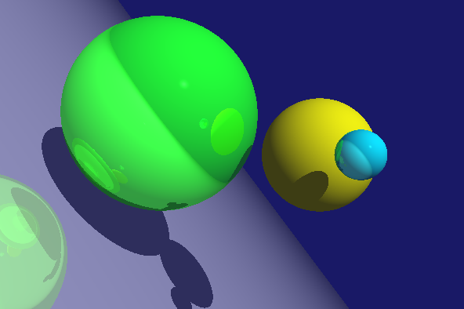
Goal
To construct a ray tracer to generate global illumination effects
E.g. reflection, shadow, etc.

Slide 3
Before We started
We have set up some useful C++ Vector class for you
For example, you can declare a vector v like this:
Vector3 v(0,0,1)
And simple operations like
Vector3 a(0,0,1), b(1,1,0);
Vector3 c = a + b
For more operations, please look up in the vector3D.h

Slide 4
Structure of the Given Skeleton
There are two cpp files given in the solution file. One is the main.cpp that contains all main operations for the ray tracer.
The other is the vector3D.cpp (and vector3D.h) that contains a library for basic vector operations. For the usage of the vector package, you can get a kick start by looking at the function renderScene() in main.cpp.

Slide 5
Default Setting
In the beginning of main.cpp, you will see:
There are two scenes (= NUM_SCENE) and the number of objects in the scene is 4 (= NUM_OBJECTS).
You will create two pictures (= NUM_SCENE) with the dimension of WINWIDTH x WINHEIGHT (600x400) and their RGB colors will be stored in the array pixel Buffer.
The program will first use the ray tracer to generate the color of each pixel in the picture and store them in pixelBuffer first. And then the buffer will be copied to the screen and displayed by glDrawPixels in the function display. In order to store the color of a pixel into the pixel buffer, you should use the function drawInPixelBuffer() provided in the code.
#define WINWIDTH 600
#define WINHEIGHT 400
#define NUM_OBJECTS 4
#define MAX_RT_LEVEL 50
#define NUM_SCENE 2
float* pixelBuffer = new float[WINWIDTH * WINHEIGHT * 3];

Slide 6

Step 1
The function intersectionWithRay should compute the intersection between the ray and the sphere, and output the smallest positive value of t according to the lecture notes.
The position of the intersection and the normal vector at the intersection should be returned through the parameters. If you do this part of code correctly, you should be able to find out all the intersection of the ray with the first sphere and colored the pixels with white (the coloring part is near the location of Step 2 in the code).

Slide 7
Step 1: Light Ray Equation
Express the ray using a parameter t :
l (t) = p + d t
l₀ = l(0) = p: origin of the ray,
d : direction vector of the ray, typically normalized,
l(t) : a set of points on the ray.
l (t) = p + d t
d
p
O_{W}

Slide 8
Example: Intersect with a Sphere
Define a sphere with center c = (X₀ ,Y₀ ,Z₀ ) and radius r.
Points lying on the sphere is given by:
( x - X₀ ) ² + ( y – Y₀ ) ² + ( z – Z₀ ) ² = r ² ( 2 )
l (t₂ )
l (t) = p + d t
l (t₁)
c
p
r
O_{W}

Slide 9
Solving the Equation
Substituting (1) into (2), the values of t at the points of intersection are obtained by solving the quadratic equation:
α t ² + β t + γ = 0 (3)
Where
α = d·d
β = 2 d· ( p - c )
γ = | p - c | ² - r ²

Slide 10
Possibilities of Intersection
If Eqn (3) has
Imaginary roots : no intersection.
2 roots : smaller positive root gives the nearer intersection.
All negative root(s): intersection(s) are behind ray origin. (Also considered as no intersection.)
1 root : the ray is tangential to the sphere. Consider no intersection.

Slide 11

Step 2
Computing the intersection with all objects.
Uncomment the for loop in the code and it should compute the intersections for all the four spheres in the scene. And it should produce the four white spheres

Slide 12

Step 2
Next, assign each pixel of the spheres with the ambient color of the spheres. You can access the ambient colors by objList[0]->ambiantReflection[i] with i is the different RGB values. And you will produce the color balls like this

Slide 13
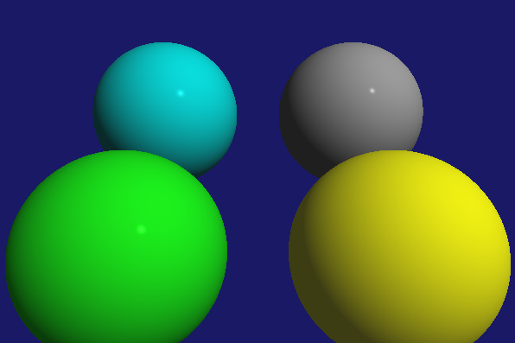
Step 3: Illumination
Compute Phong Illumination Equation for the points on the sphere according to Lecture 8.

Slide 14
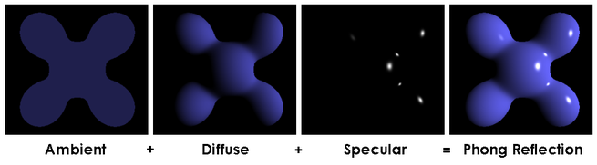
Phong Illumination Equation (PIE)
For every point on a surface, we can compute its color/intensity by the Phone Illumination Equation:
Capital letters are 3 x 1 vectors and small caps are just constants

Slide 15
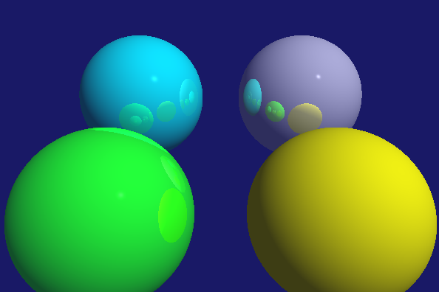
Step 4: Ray Tracing
Finished the code by recursively tracing the ray. The recursive level should not exceed MAX_RT_LEVEL .
You can assume that a ray will not hit an object where it rebounds from. So the variable fromObj is for that purpose. If your reflection is done correctly, you should produce a picture like this. Note that the yellow sphere is supposed to be dull and have no reflection.

Slide 16
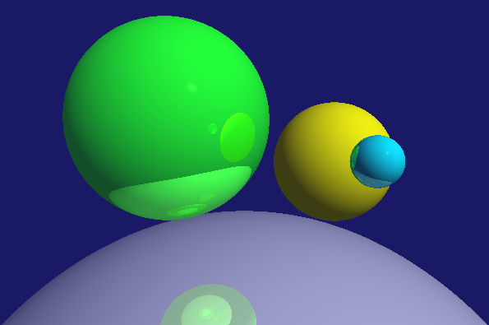
Step 5: Add another scene
By pressing the letter ‘s’, another scene is rendered. Basically the algorithm should be the same and all you need to do is to change the settings. Your job is to create another scene by changing the positions and the material properties for the objects. Try to avoid having intersecting objects.

Slide 17
Submission
You should only modify and hand in the file main.cpp.

Slide 18
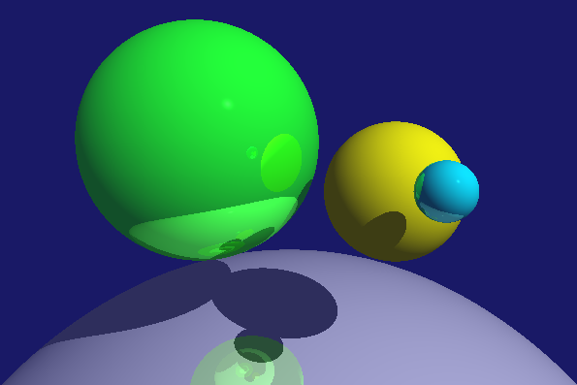
Extra Feature Suggestions
Add shadows

Slide 19
Extra Feature Suggestions
Add another type of objects
E.g. how to add a plane

Slide 20
Extra Feature
Sphere is a inherited class from the class RTObjects.
You can create another class by the same method
class Plane : public RtObject {
// the plane of any point v such that v . n = d
Vector3 n_;
double d_;
public:
Plane(Vector3 n, double d) { n_ = n; d_ = d; };
void set(Vector3 n, double d) { n_ = n; d_ = d; };
double intersectWithRay(Ray, Vector3& pos,
Vector3& normal);
};

Slide 21
Extra Feature
And because the function is virtual. You just need to implement the version for the plane
double Plane::intersectWithRay(Ray r, Vector3& intersection,
Vector3& normal)
{
// l(t) = r.start + t * r.dir
// so l(t) . n = d r.start.n + t * r.dir.n = d
// t = (d-r.start dot n)/(r.dir dot n)
double t = (d_ - dot_prod(r.start, n_)) / (dot_prod(r.dir, n_));
intersection = r.start + r.dir * t;
if (dot_prod(r.dir, n_) > 0)
normal = -n_;
else
normal = n_;
return t;
}

Slide 22
Extra Feature
Because the plane is explained in this slides, so plane is not counted as an extra feature.
But you can implement
Polygons
Polytopes, such as cubes
Conics, other than spheres and ellipsoids
Or other implicit functions
It may be surprising easier than you thought

Slide 23
Extra Feature Suggestions
Texture maps, bump maps, etc.
Transparency
Seemingly to be easy. But the difficulty lies at the numerical error of intersecting the same object.

